Slide 1

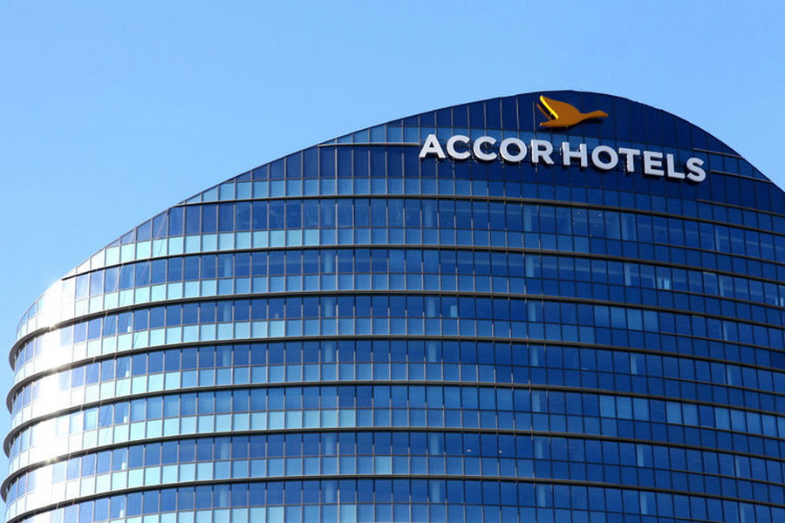
Accor S.A. Investment Research Analysis

Slide 2
Company Information

Slide 3
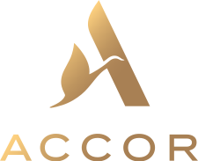
Background
Hotel Accor is a world-leading augmented Frech hospitality company.
It’s founded by Gérard Pélisson and Paul Dubrule in 1967
Accor operates in 110 countries with an extensive portfolio of 5400 hotels, and it’s still constantly expanding.

Slide 4
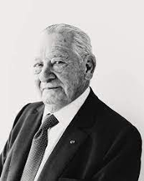
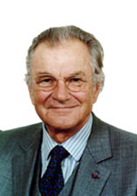
Founders
Gérard Pélisson (1932.2.9 – 2023.3.6)
Gérard Pélisson was a French hotelier and businessman. He was a graduate of MIT and was the president of the Union des Francais de l’Etranger. He co-founded the Accor Group with Paul Dubrule in 1967. He died on March 6th, 2023 at the age of 91.
Paul Dubrule
Paul Dubrule is a French Businessman and politician. He is graduated from the University of Geneva. He was a member of the French Senate from 1999 to 2004, representing Seine -et-Marne. He co-founded the Accor Group with Gérard Pélisson in 1967.

Slide 5
Brief History
Dubrule and Pélisson noticed that the hospitality industry in France was less developed
They bring American style hotel to France and Accor was borned
The company expanded to include locations at airports and popular vacation sites along seasides and in mountain regions.
With the acquisition of Sofitel Hotels in 1982, Novotel and its holdings were integrated under the name Accor.
They entered the US market by bringing hotels and seafood broiler restaurant chains.

Slide 6
Board of Directors
Sébastien Bazin – chairman and CEO
Iris Knobloch – Independent Director, and Vice-Chairman
Asma Abdulrahman Al-Khulaifi – Director
Ugo Arzani – Director
Hélène Auriol Potier – Independent director
Iliane Dumas – Director representing employees
Qiong’Er Jiang – Independent director
Anne-Laure Kiechel – Independent Director
Anne-Laure Kiechel – Independent Director
Bruno Pavlovsky – Independent Director
Nicolas Sarkozy – Independent Director
Christine Serre – Director representing employees
Isabelle Simon – Independent Director
Sarmad Zok – Director

Slide 7

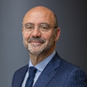
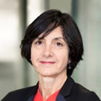
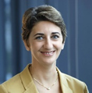


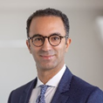


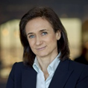
Executive Management
Sébastien Bazin Jean-Jacques Morin Martine Gerow Besma Boumaza Steven Daines
Brune Poirson Kamal Rhazali Floor Bleeker Alix Boulnois Caroline Tissor

Slide 8
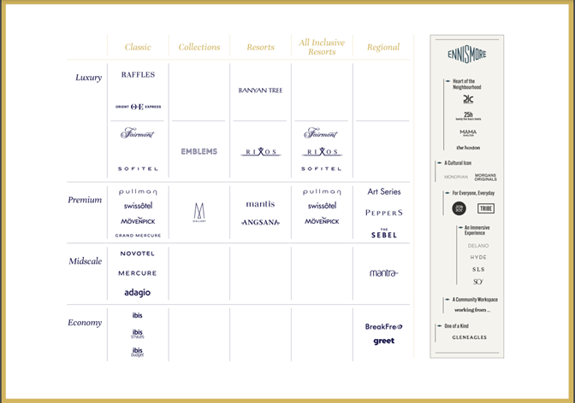
Product Positioning
Brand portfolio:
live:
more than 40 brands, form luxury to economy
work:
over 18500 meeting rooms and coworking areas
wellness:
more than 600 hotel Spas, 1,000 fitness clubs
events & catering:
more than 60,000 apartments, villas, and chalets.

Slide 9
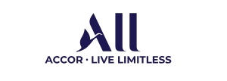
Product Positioning
Target Market and Customer Segments
Leisure Travelers
Families and Group Travelers
Business Travelers and Corporates
Luxury Seekers
Customer Relations
Accor Customer Digital Card Database
“All-Accor Live Limitless” program

Slide 10
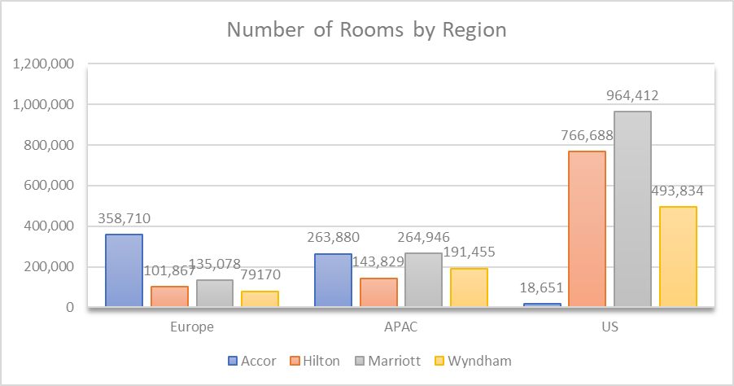
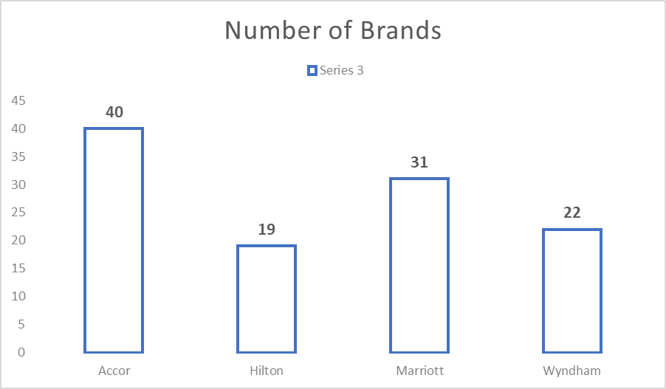
Competitive Analysis Globally
Direct Competitors
Accor’s major competitors are Marriott International, Hilton Worldwide Holdings, InterContinental Hotel Group, Hyatt Hotels Corporation, and Wyndham Hotels & Resorts.

Slide 11
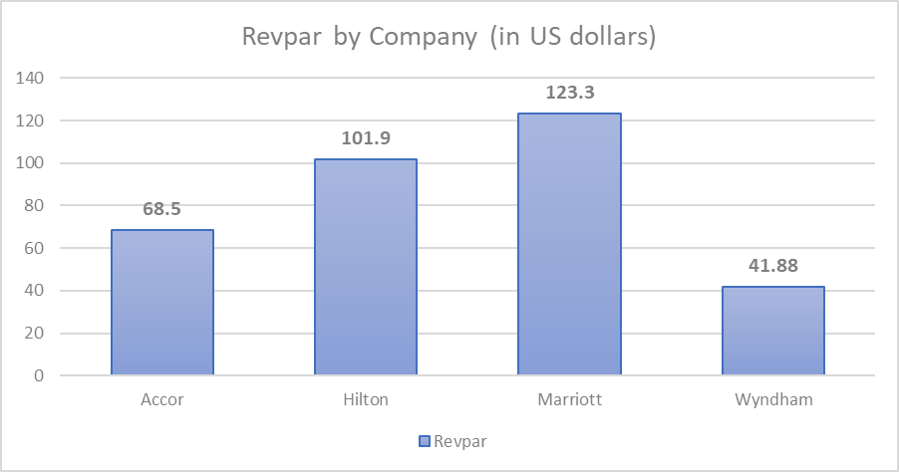
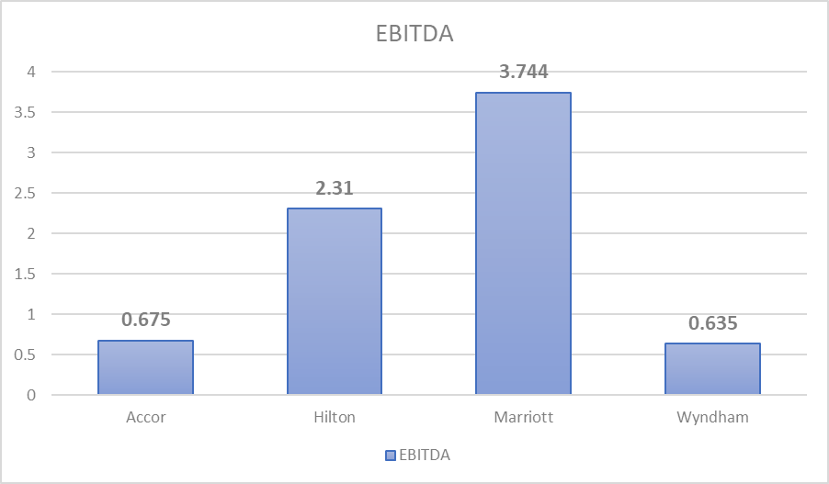
Competitive Analysis Globally

Slide 12
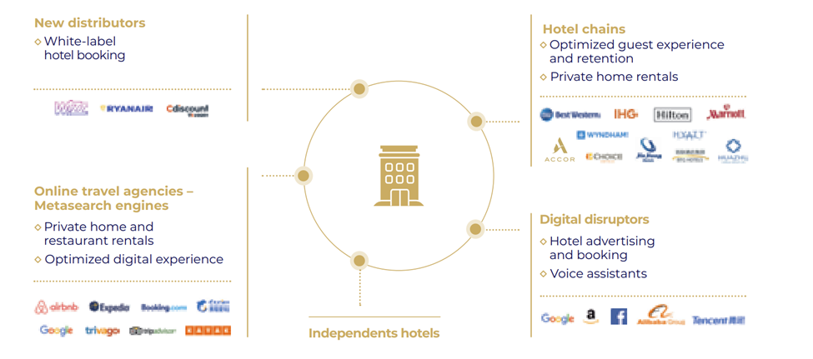
Competitive Analysis Globally
Indirect Competitors
Online Travel Agencies (e.g. booking.com) & Private Home Rental Platform (e.g. Airbnb)

Slide 13
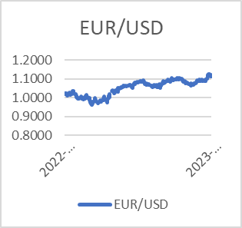
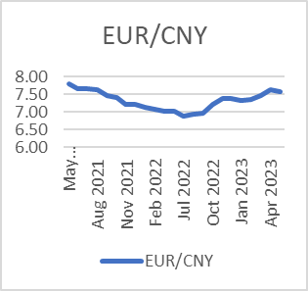
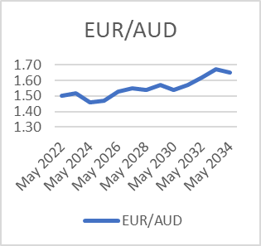
Risk Management
Foreign Exchange risk
if Euros appreciate, there will be reduction in revenue when converting currencies into Euros for financial reporting.
fluctuations may also impact Accor’s competitiveness

Slide 14
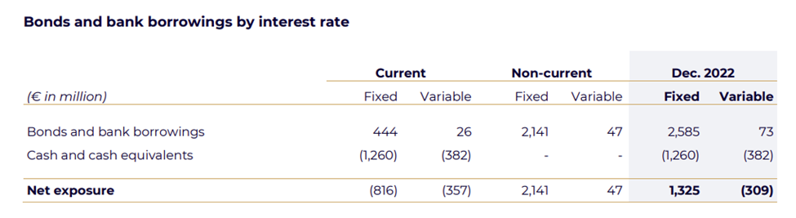
Risk Management
Interest Rate risk
As of December 31, 2022, 97% of bonds and bank borrowing were at a fixed rate, with an average rate of 2.1% and 3% were at a variable rate, with an average of 5%. The fixed rate debt is denominated primarily in euros.
the fluctuations in interest rates will also affect the customers’ behaviors and hinder Accor from expanding

Slide 15
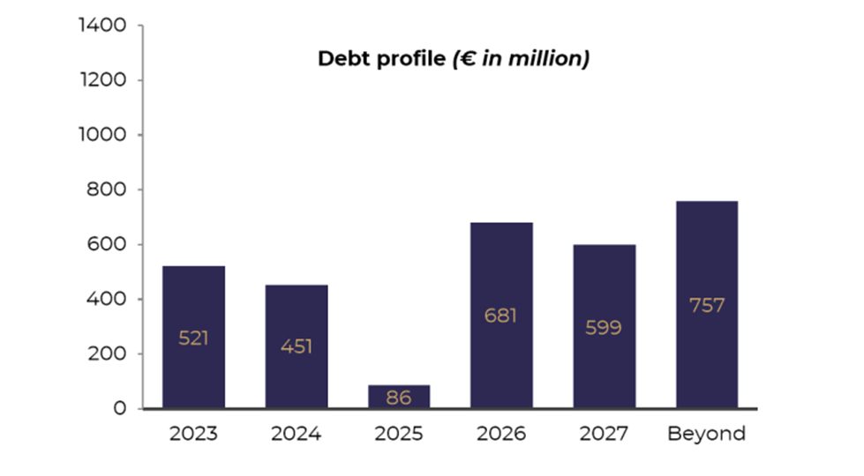
Risk Management
Liquidity Risk
Accor has one undrawn confirmed credit line for €1,200 million, maturing in June 2024 (for €86 million) and in June 2025 (for €1,114 million).
liquidity risk may be incurred by:
fluctuations in revenue
changes in economic conditions
occurrence of unexpected events

Slide 16
Risk Management
Risk specifically for hospitality industry
Climate Risk
Geopolitical Risk
Cyber Risk
Operational Risk
Seasonal Fluctuations
Natual Disasters and Emergencies
Supply Chain Disruption

Slide 17
Market Research

Slide 18
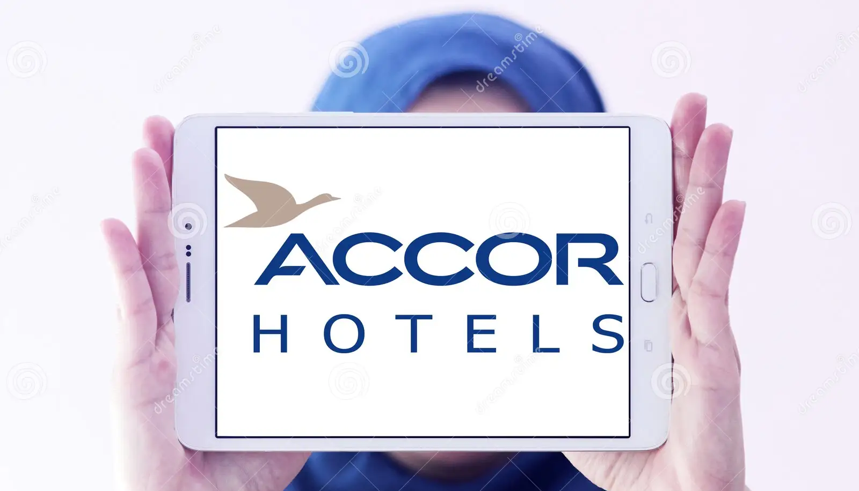
Market Research
AccorHotels increases brand recognition through:
- Digital marketing on social media and search engines, along with influencer collaborations.
- Promoting its loyalty program for customer engagement.
- Partnerships with travel agencies and lifestyle brands.
- Event sponsorships to enhance visibility.
- Emphasizing CSR and sustainability initiatives.

Slide 19
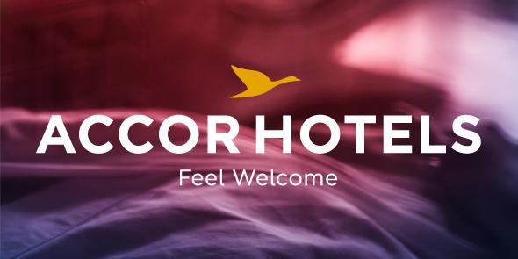
Brand Positioning
Market Share:
Strong global positioning, holding the sixth position worldwide and leading in Europe.
Over 40% market share outside France and one-third within France.
Company Rankings from Industry Organizations:
Diverse brand portfolio catering to luxury, mid-range, and economy segments.
Focus on personalized guest experiences and augmented hospitality.
Asset-light model for solid financial performance and continuous growth.
Commitment to sustainability and proactive expansion through acquisitions.
Overall, these factors contribute to its recognition as a major player in the industry.

Slide 20
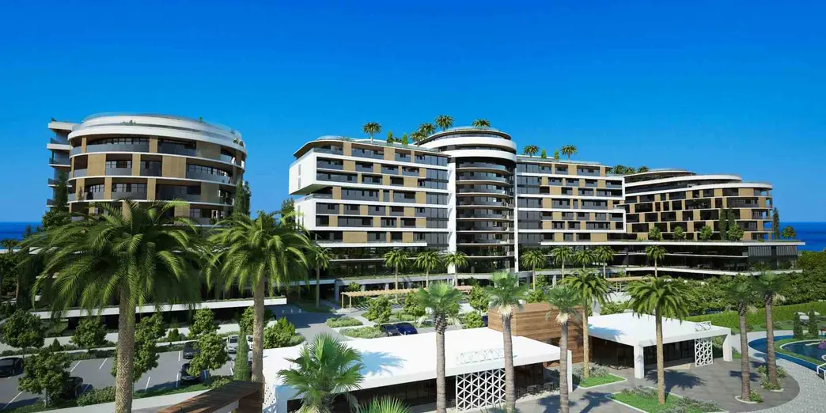
Franchise
Accor offers franchise agreements to hotel owners, providing access to popular brands and services.
Collaborates with partners like Sunmei Digital Intelligence Group and Groupe ADP to expand globally.
Revenue generated from fees including trademark, distribution, and marketing.
Strategic approach leverages partner resources to grow its renowned hotel brands.

Slide 21
Mergers and Acquisitions

Slide 22
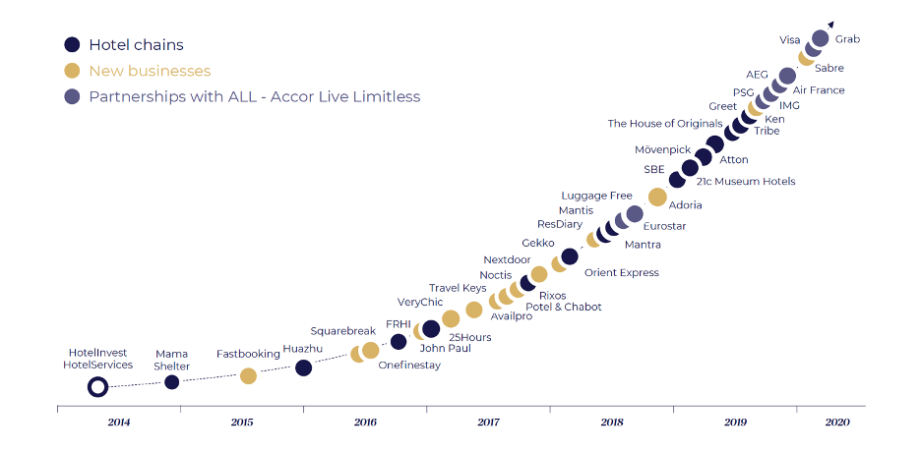
Mergers and Acquisitions

Slide 23
Mergers and Acquisitions
Two most recent acquisitions:
Three acquisitions with the highest deal amounts:

Slide 24
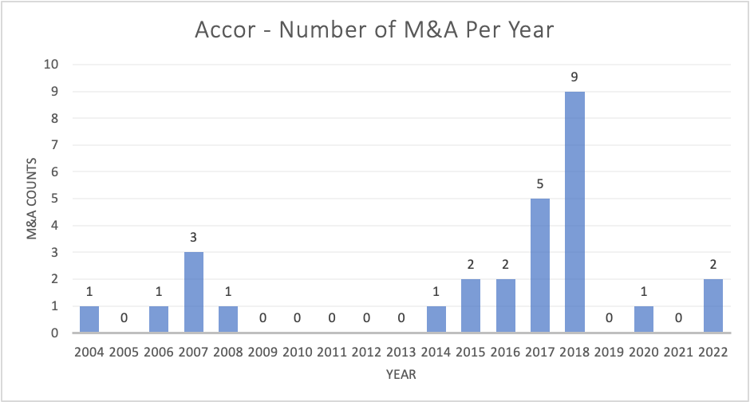
Mergers and Acquisitions
- Peaking in 2018 with nine acquisitions.
- In 2018, their cash reserves increased significantly, likely facilitated by strategic selling of assets.
- After COVID-19, Accor's capital management remained healthy, and their M&A activity stayed within their financial capacity.

Slide 25

Collaborations
15 Joint Ventures and 14 Cooperation Agreement worldwide, strategically expanding its global reach.
10 Partnerships (Avis, Traveloka, IndiGo, Zrou, Cvent, BNP Paribas, Axa S.A, Visa, Dubai Multi Commodities Centre, Ctrip)

Slide 26
Quantitative Analysis

Slide 27
Sources of Income
Management & franchise: fees from managing hotels for franchisees and procurement commission
5 geographic areas: Southern Europe, Northern Europe, Asia Pacific, Americas, and Others (India, Middle East, Africa, Turkey)
Services to owners
Supporting services (sales, marketing, loyalty program, cost reimbursement)
Hotel assets & other
Accommodations & food and beverage from Accor owned hotels
New revenue generating activities (hotel booking, AccorPlus rewards program)

Slide 28
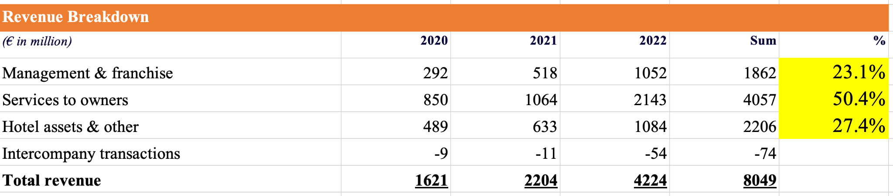
Sources of Income Cont.
Heavily relies on providing hotel operating services as opposed to managing their own hotel assets
Resonates with Accor’s asset-light strategy

Slide 29
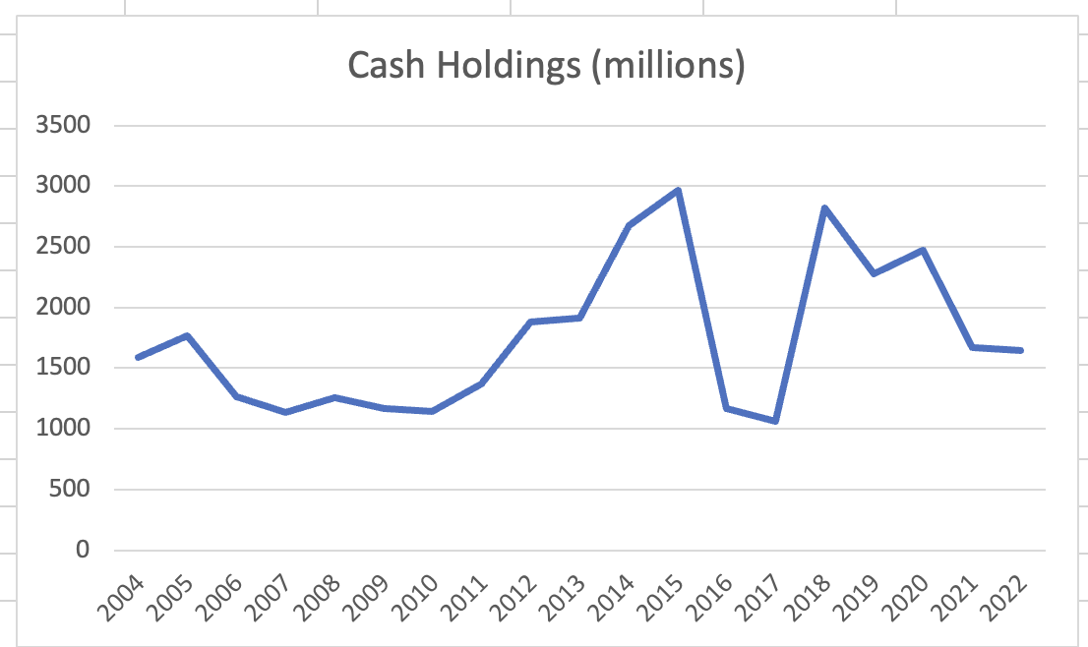
Cash Holdings
Acquisition of FRHI Holdings in December 2015 can be attributed to the sharp drop in cash
2018 cash reserve hike is caused by selling of assets for strategic transition and preperation for Mantra Group acquisition

Slide 30
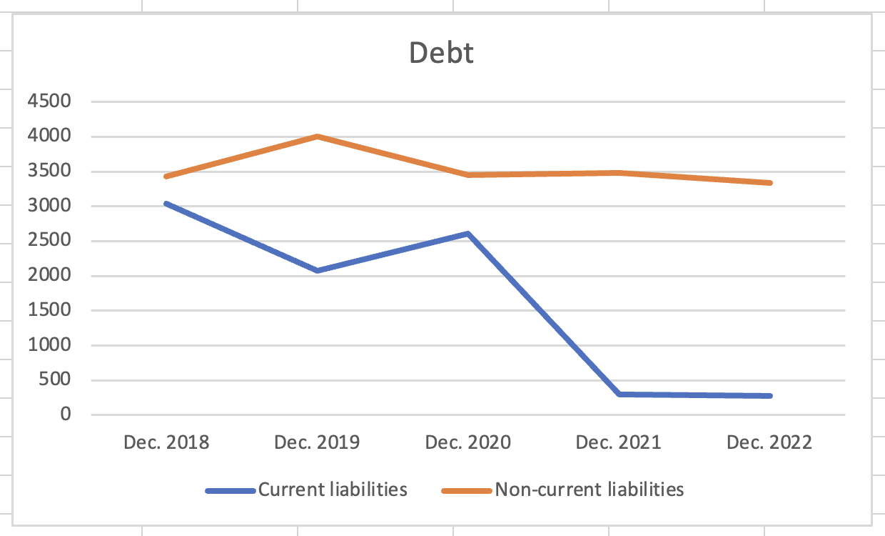
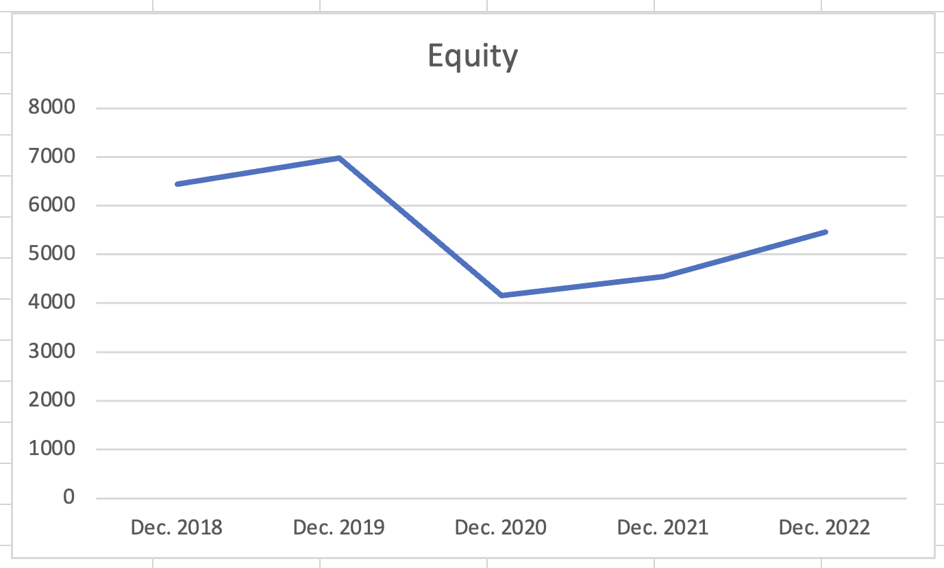
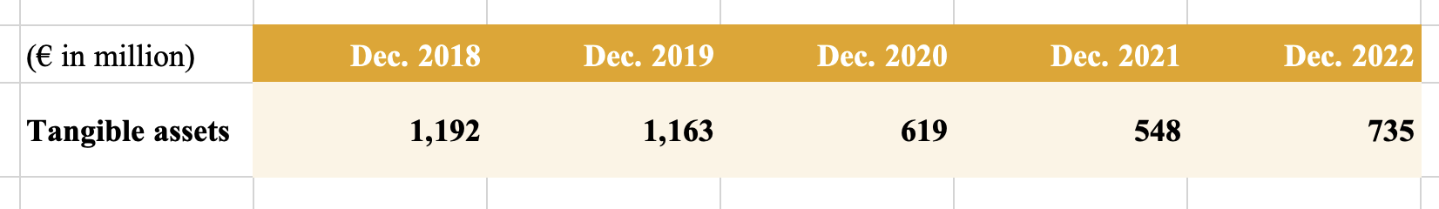
Capital Structure
2020 to 2021 sharp drop in current liabilities is due to decrease in financial debt likely caused by less reliance on debt with cash from asset sale
2019 to 2020 decline is due to low net profit from impacts of covid

Slide 31
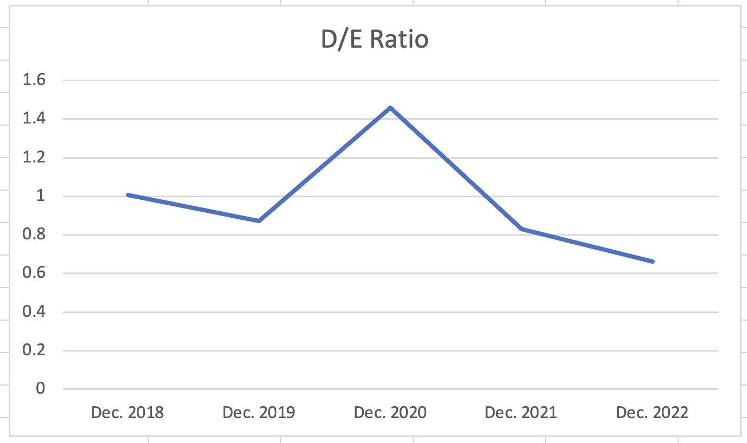
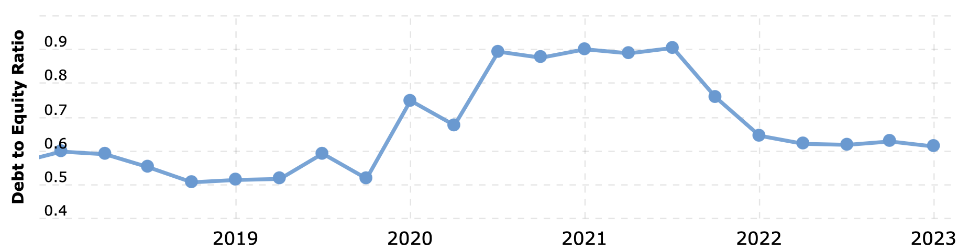
Capital Structure (D/E Ratio)
2020 increase is caused by anomaly of equity decline from covid
Fluctuates between 0.6 to 1 omitting the anomaly, indicating relatively low financial risk
Accor is diversified and not a typical hospitality company but its D/E ratio resembles one

Slide 32
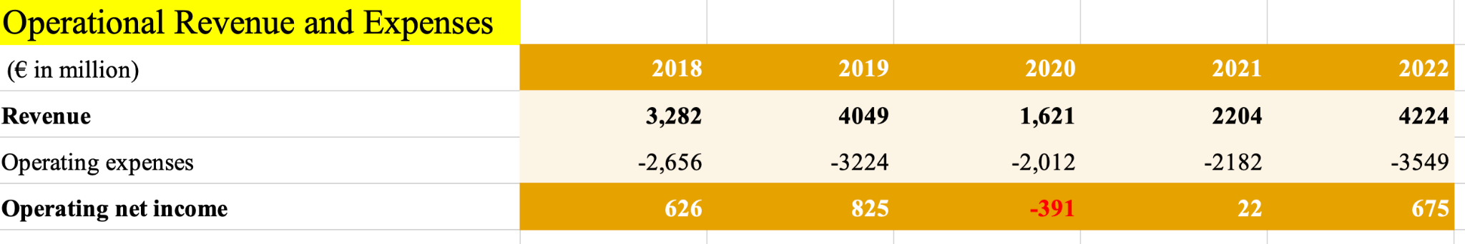
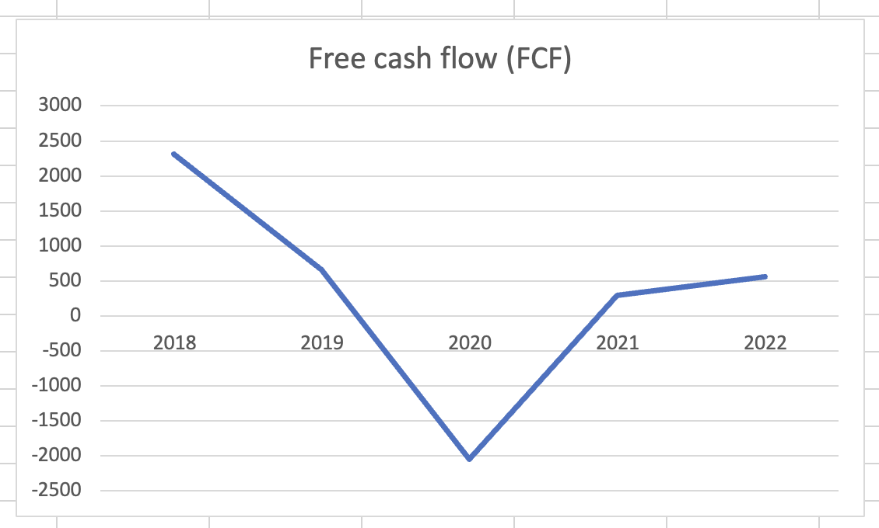
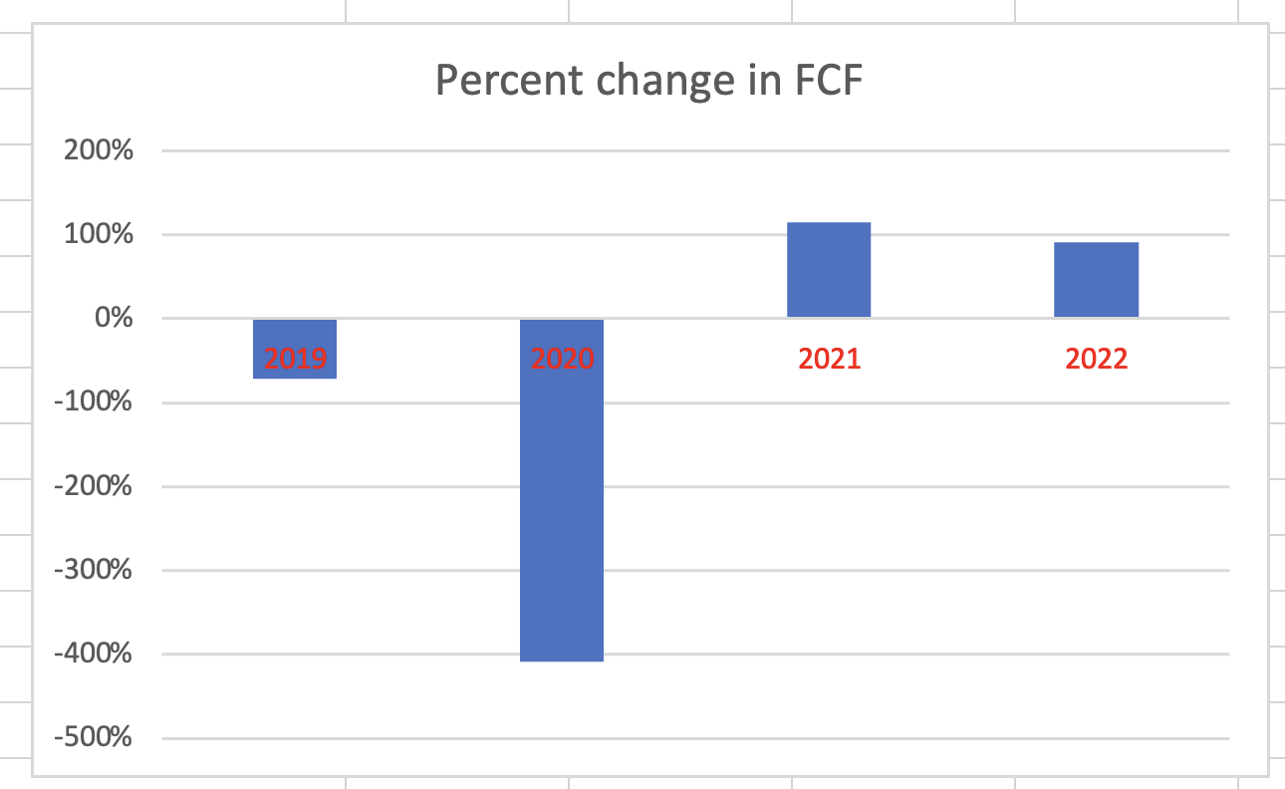
Break-even & FCF Analysis

Slide 33
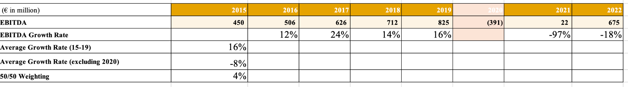
DCF Analysis
Compute EBITDA growth rate
Use average of pre-covid growth rate and post-covid growth rate to minimize inaccuracy

Slide 34
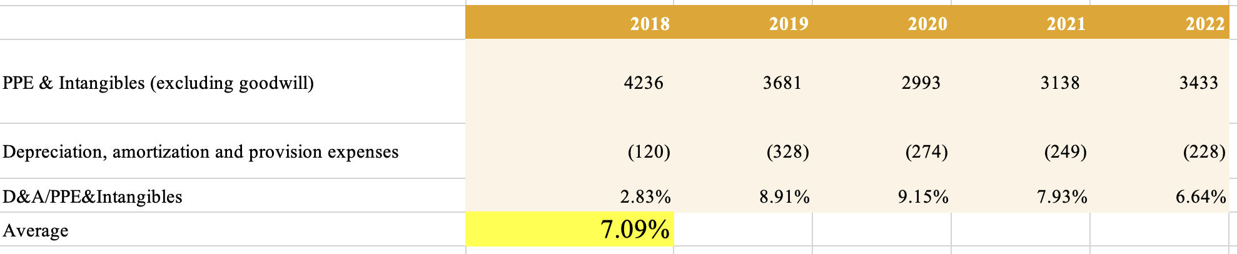
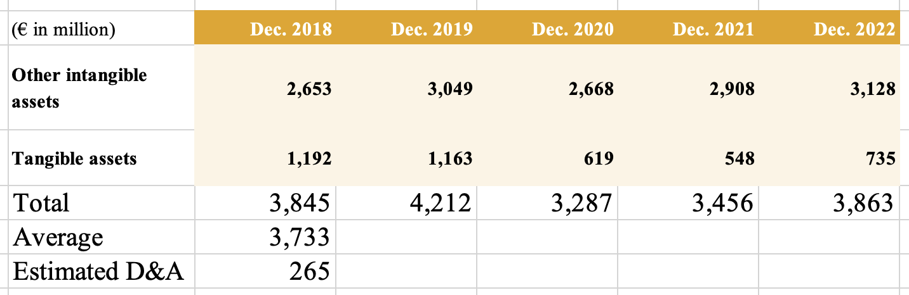
DCF Analysis Cont.
Compute ratio of D&A over PPE & Intangibles
Googwill is omitted because it is impaired not amortized
Use ratio to estimate D&A

Slide 35
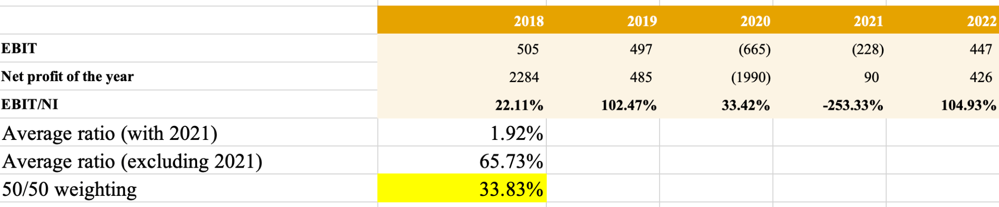
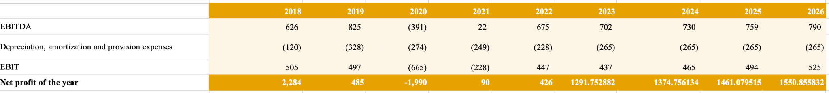
DCF Analysis Cont.
Compute net profit

Slide 36
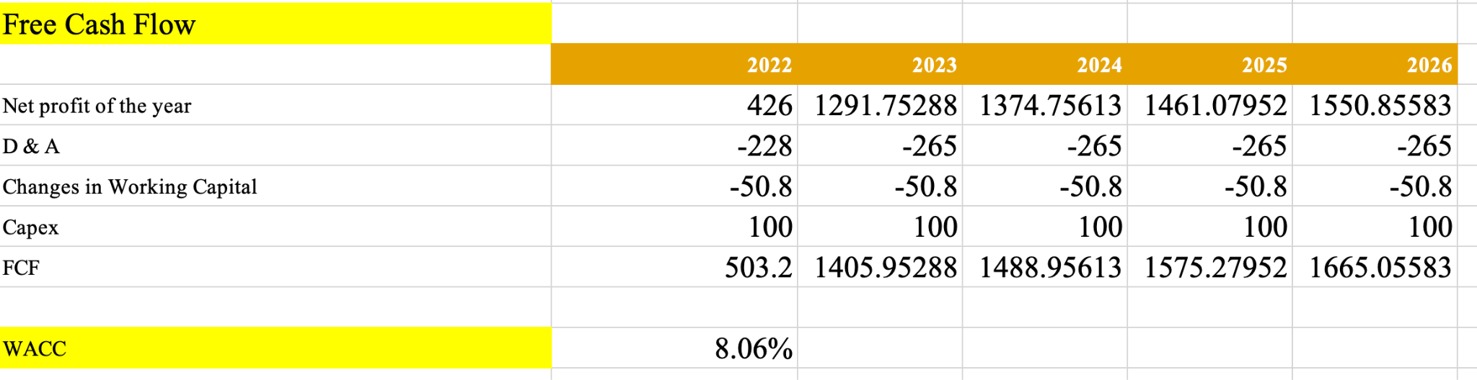
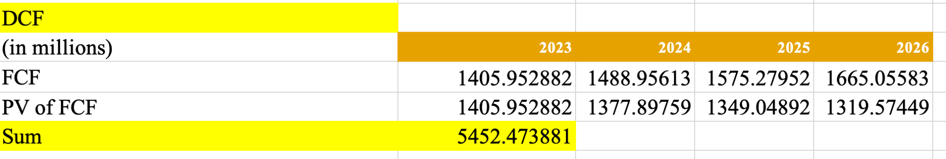
DCF Analysis Cont.
Compute present value of estimated cash flows

Slide 37
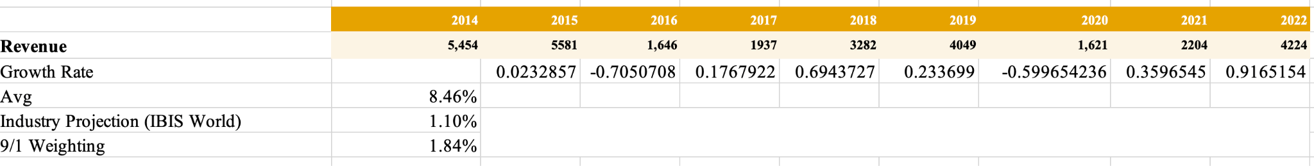
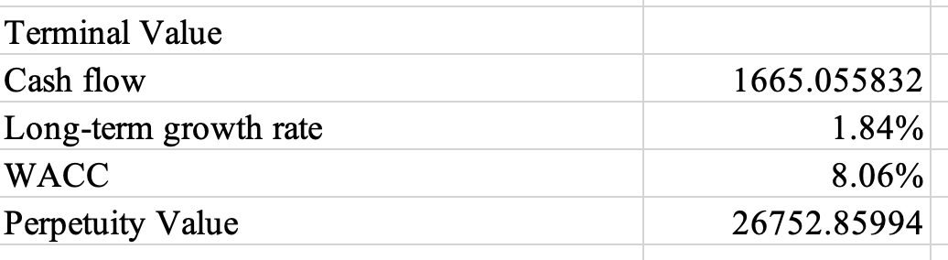
DCF Analysis Cont.
Compute terminal value
Industry projection used because Accor’s business is highly correlated to the fluctuations in the hospitality industry despite its three distinct revenue sources

Slide 38
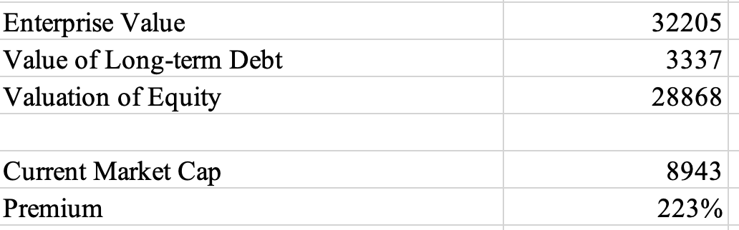
DCF Analysis Cont.
Enterprise value - Value of long-term debt = Value of equity
Using a current market capitalization of 8,943 million, the premium is 223%
DCF is only a reference and not an accurate assessment due to Accor’s changing business strategies and diverse holdings

Slide 39
Stock Price Analysis

Slide 40
Stock Price Since IPO
Stock code: FR0000120404
Listed on: Euronext Paris stock market in 2000 till now
IPO price (1989): €12.01 (exact valuation unknown)
Current closing price (as of July 25, 2023): €37.90 with market cap of €9.87 Billion

Slide 41
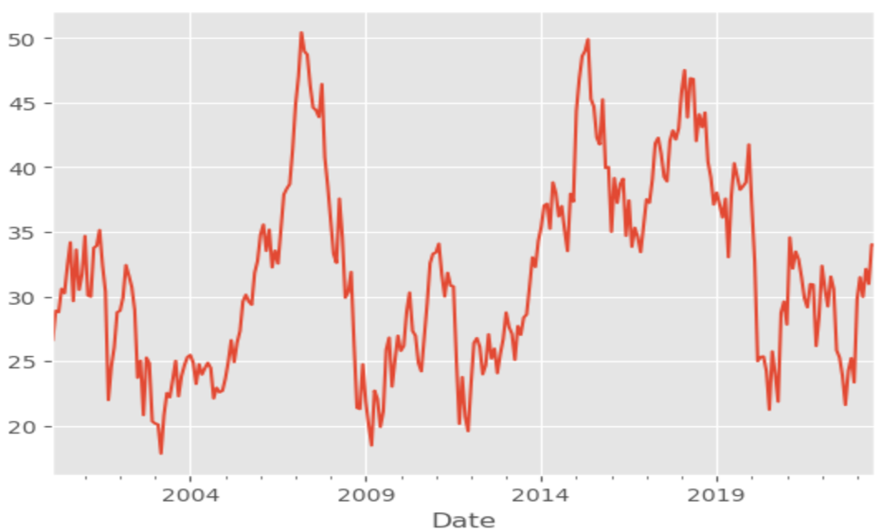
Stock Price Growth
Accor experienced fluctuations in its stock price over time.
Two important peak points:
- 11-Jul-2007 €53.08
- 28-May-2018 €48.95

Slide 42
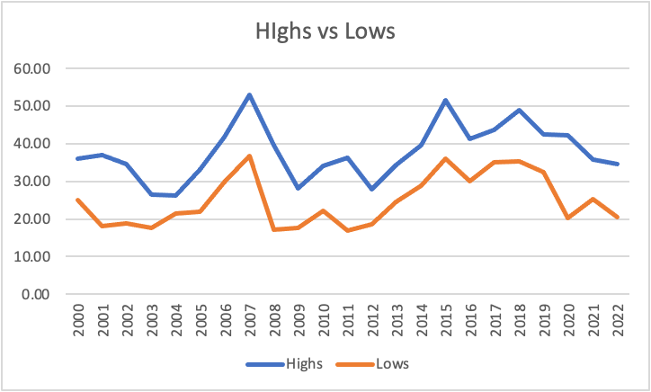
Year by Year Stock Price Highs and Lows
Stock Price Highs:
07/11/2007 €53.08 (Highest)
04/22/2015 €51.65
05/28/2018 €48.95
* 06/30/2023 €34.40 (This year)
Stock Price Lows:
12/14/2011 €17.03 (Lowest)
10/27/2008 €17.07
10/10/2002 €17.63
* 01/01/2023 €23.39 (This year)

Slide 43
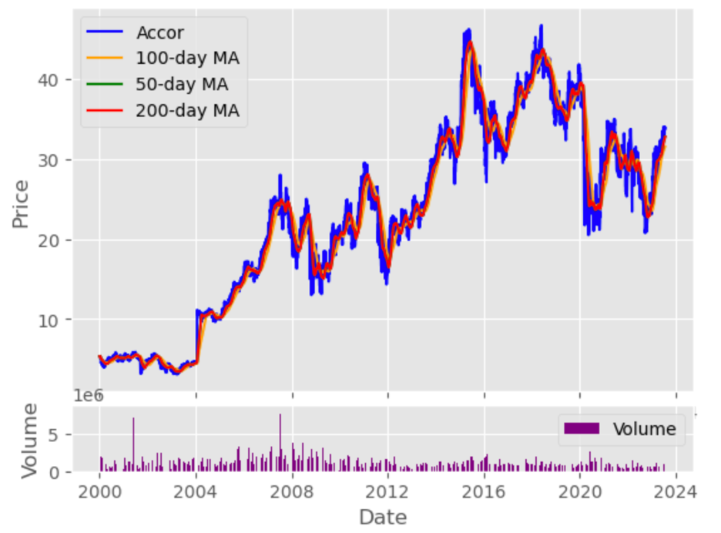
Stock Price Moving Average Analysis
Accor’s stock performance, reflected in the 50, 100, and 200-day moving averages, shows positive trends. This is supported by solid earnings and a promising EPS, indicating a healthy financial position.

Slide 44
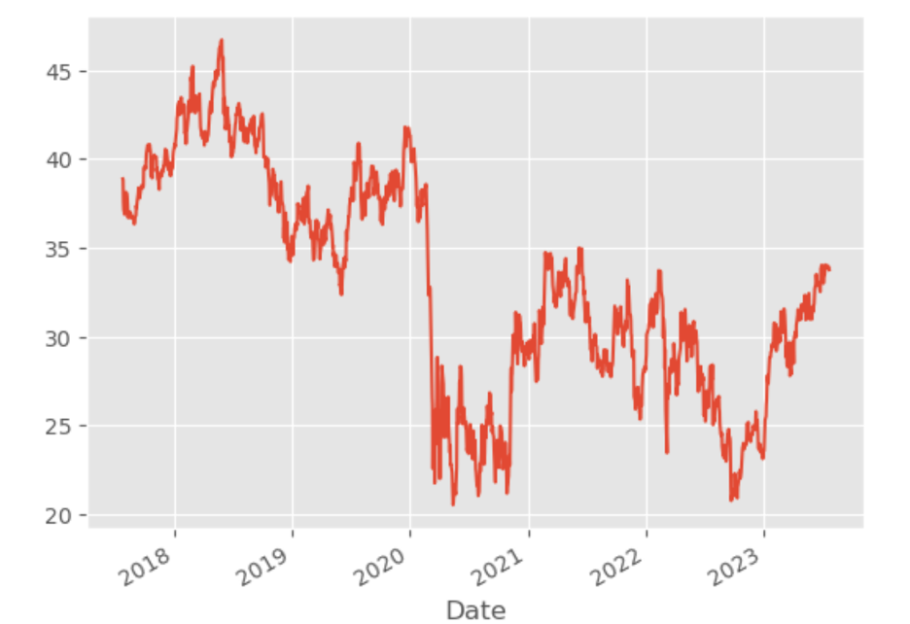
Price/Earning Ratio 6 Years
P/E ratio = -152.44, while both IHG and Marriott generally maintained positive P/E ratios.

Slide 45
Index Analysis

Slide 46


Index Analysis

Slide 47

Competitor Index
Until 2012, Accor consistently demonstrated a better stock price. Since 2012, Accor has consistently maintained the lowest stock price

Slide 48

CAC 40 Index
CAC 40 represents the 40 largest and most actively traded companies listed on Euronext Paris, the French stock exchange.
Accor had experienced larger fluctuations than the index. Before June, Accor had consistently performed below the index, but it surpassed the index after June.

Slide 49

Europe Industry
STOXX Europe 600 Travel and Leisure Index: Tracks companies engaged in the travel and leisure industry, including airlines, hotels, restaurants and travel agencies from 17 European countries.

Slide 50

US Hotel Industry
Dow Jones US Hotel Index: The Dow Jones US Hotel Index specifically focuses on companies within the hotel sector, such as hotel chains, resorts, operating in the United States.

Slide 51

S&P 500
The S&P 500 is the index that tracks the performance of 500 large companies listed on U.S. stock exchanges. It is a benchmark for the overall performance of the U.S. stock market.
Between 2017 and 2021, S&P 500 saw steady gains while Accor faced mixed performance due to industry volatility and the COVID-19 impact. Since 2021, S&P 500 stayed high, while Accor remained stable but lower.

Slide 52
SWOT Analysis

Slide 53


SWOT analysis
Strengths:
Global presence in 110+ countries.
Diverse brand portfolio.
Strong solvency position.
Emphasis on augmented hospitality.
Pursuit of strategic initiatives.
Weaknesses:
Cost Efficiency Decline and Liquidity Risk.
Adverse impact of the ongoing pandemic on operations and financial performance.
Reliance on online travel agencies for bookings.

Slide 54


SWOT analysis
Opportunities:
Luxury and upscale segment growth.
Expanding in China.
Strategic initiatives and partnerships.
Business expansion and acquisitions.
Growing accommodation sector in France.
Threats:
Stiff competition from various hotel operators.
Online theft and hacking risks.
Competitive brandjacking.
Impact of changing regulations.
Economic and geopolitical factors.
Dependency on the tourism industry.

Slide 55
Thank You!

